Slide 1
Artificial Neural Networks

Slide 2
Two Groups of Researchers about
Artificial Neural Networks (ANNs)
Use ANNs to study and model biological learning processes
Obtain highly effective machine learning algorithms inspired by biological neural networks

Slide 3
Properties of Artificial Neural Nets
Many neuron-like threshold switching units
Many weighted interconnections among units
Highly parallel distributed process
Emphasis on tuning weights automatically

Slide 4
When to Consider Neural Networks
Input is high-dimensional discrete or real-valued
  E.g. raw sensor input
Output is discrete or real valued
Output is a vector of values
Possibly noisy data
Form of target function is unknown
Human readability of result is unimportant

Slide 5
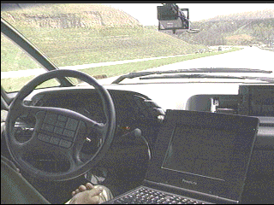
ALVINN Drives 70 Mph on Highways
Output Layer
30 output units
The weights from the hidden unit to the 30 output units
The learned weights for the 30x32 pixel inputs associated with one hidden unit
Hidden Layer
4 hidden units
Input Layer
30x32 input units

Slide 6
Perceptron
-w₀ is a threshold

Slide 7
Perceptron
Learning a perceptron involves choosing values for the weights w₀,…,w_{n}
Hypothesis space H
  The set of all possible real-valued weight vectors

Slide 8
Decision Surface of a Perceptron
View the perceptron as representing a hyperplane decision surface in the n-dimensional space of instances
linear separable
Nonlinear separable

Slide 9
Representation Power of
Perceptrons
Perceptron can represent AND, OR, NAND, and NOR, but cannot represent some boolean functions such XOR
  AND
    w₀=-0.8, w₁=w₂=0.5
  OR
    w₀=-0.3, w₁=w₂=0.5

Slide 10
Representation Power of
Perceptrons
Every boolean function can be represented by some network of perceptrons only two levels deep
  e.g. represent the boolean function in DNF
    First layer: AND
    Second layer: OR

Slide 11
Perceptron Training Rule
Learning the weights for a single perceptron
where
t is the target value
o is the perceptron output
η is a small constant called learning rate

Slide 12
Perceptron Training Rule
Perceptron learning
  1. Choose the learning rate η >0 and initial weight vector W1
  2. Apply the next training pair to the perceptron
  3. Adapt the weight vector using the perceptron training rule
  4. Stop the adaptation of the weights if all data points are classified correctly. Otherwise, go to Step 2.

Slide 13
Perceptron Training Rule
Can prove it will converge
  If training data is linearly separable
  and η sufficiently small

Slide 14
Gradient Descent
To understand, consider simpler linear unit where
Let’s learn w_{i}’s that minimize the squared error
Where D is set of training examples

Slide 15
Gradient Descent

Slide 16
Gradient Descent
Gradient
Training rule
where
  i.e.

Slide 17
Gradient Descent

Slide 18
Gradient Descent
Gradient-Descent(training_examples, η)
Initialize each w_{i} to some small random value
Until the termination condition is met, do
  Initialize each Δw_{i} to zero
  For each <x,t> in training_examples, do
    Input the instance x to the unit and compute the output o
    For each linear unit weight w_{i}, do
  Δw_{i}= Δw_{i}+ η(t-o)x_{i}
  • For each linear unit weight w_{i}, do
w_{i}=w_{i}+ Δw_{i}

Slide 19
Summary
Perceptron training rule guaranteed to succeed if
  Training examples are linearly separable
  Sufficiently small learning rate η
Linear unit training rule uses gradient descent
  Guaranteed to converge to hypothesis with minimum squared error
  Given sufficiently small learning rate η
  Even when training data contains noise
  Even when training data are not linear separable

Slide 20
Difficulties of Gradient Descent
Practical difficulties in applying gradient descent
  Converging to a local minimum can sometimes be quite slow
  If there are multiple local minima in the error surface, then there is no guarantee that the procedure will find the global minimum

Slide 21
Incremental (Stochastic)
Gradient Descent
Approximate gradient descent search by updating weights incrementally, following the calculation of the error for each individual example
Weight update
Error function for each training example

Slide 22
Incremental (Stochastic)
Gradient Descent
Batch mode gradient descent
  Do until satisfied
    1.Compute the gradient
    2.
Incremental mode gradient descent
  Do until satisfied
    For each training example d in D
      Compute the gradient

Slide 23
Incremental (Stochastic)
Gradient Descent
Incremental mode gradient descent can approximate batch gradient descent arbitrarily closely if η made small enough

Slide 24
Multilayer Networks
Decision surface and test examples
Speech recognition – distinguish 10 vowels in the context of “h_d”

Slide 25
Sigmoid Unit
σ(x) is the sigmoid function
Nice property
We can derive gradient descent rules to train
  one sigmoid unit
  multilayer networks of sigmoid units → Backpropagation

Slide 26
Error Gradient for a Sigmoid Unit

Slide 27
Error Gradient for a Sigmoid Unit

Slide 28
Backpropagation Algorithm
Create a feed-forward network with n_{in} inputs, n_{hidden} hidden units, and n_{out} output units
Initialize all weights to small random numbers
Until satisfied, do
  For each training example, do
  Propagate the input forward through the network:
    Input the training example to the network and compute the network outputs

Slide 29
Backpropagation Algorithm
  Propagate the errors backward through the network:
  For each output unit k, calculate its error
  For each hidden unit h
  Update each network weight w_{ij}
    where

Slide 30
More on Backpropagation
Gradient descent over entire network weight vector
Easily generalized to arbitrary directed graphs
Will find a local, not necessarily global error minimum
  In practice, often works well (can run multiple times)

Slide 31
More on Backpropagation
Epoch
  One training cycle through the entire training dataset
Mini-Batch Gradient Descent
  Split the training dataset into small batches that are used to calculate model error and update model coefficients.

Slide 32
More on Backpropagation
Often include weight momentum α
Minimizes error over training examples
  Will it generalize well to subsequent examples?
Training can take thousands of iterations → Slow!
Using network after training is very fast

Slide 33
Learning Hidden Layer Representations
Can this be learned ?

Slide 34
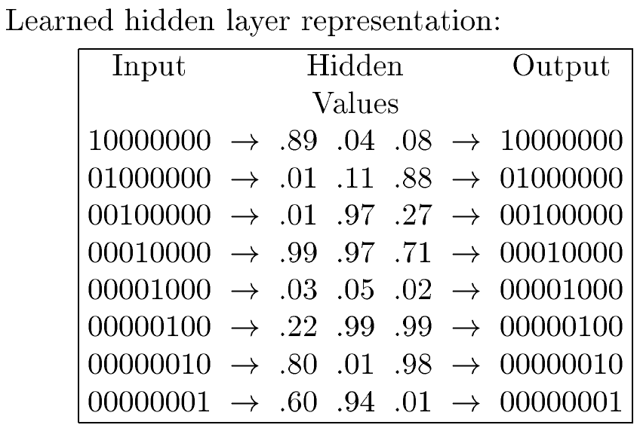
Learning Hidden Layer Representations
100
001
010
111
000
011
101
110

Slide 35
Learning Hidden Layer Representations
Hidden layers can capture properties of the input instances that are most relevant to learning the target function
The ability of multilayer networks to automatically discover useful representations at the hidden layers is a key feature of ANN learning

Slide 36
Training
Initial weights: random values (-0.1 ~0.1)
η=0.3

Slide 37
Training
The network passes through a number of different encodings before converging to the final encoding

Slide 38
Training
Significant changes coincide with significant changes in the hidden layer encoding and output squared errors

Slide 39
Convergence of Backpropagation
Gradient descent to some local minimum
  Perhaps not global minimum
  Add momentum
  Stochastic or mini-batch gradient descent
  Train multiple nets with different initial weights
Nature of convergence
  Initialize weights near zero
  Therefore, initial networks near-linear
Increasingly nonlinear function as possible as training progresses

Slide 40
Expressive Capabilities of ANNs
Boolean functions
  Every boolean function can be represented by network with single hidden layer
  but might require exponential (in number of inputs) hidden units
Continuous function
  Every bounded continuous function can be approximated with arbitrarily small error, by network with one hidden layer [Cybenko 1989; Hornik et al. 1989]
Arbitrary function
  Any function can be approximated to arbitrary accuracy by a network with two hidden layers [Cybenko 1988]

Slide 41
Hypothesis Space Search and
Inductive Bias
The hypothesis space is the n-dimensional Euclidean space of the n network weights
  Hypothesis space is continuous
Inductive bias: Smooth interpolation between data points
  Backpropagation tends to label samples between two positive training examples positive

Slide 42
Overfitting in ANNs
Overfitting

Slide 43
Avoid Overfitting in ANNs
Using validation set
  Store the network weights of the best-performing thus far
  If current weights has an error significantly higher than that of the stored (best) ones, training is terminated and the stored weights are returned as the final hypothesis

Slide 44
Avoid Overfitting in ANNs
do not stop training too soon when
validation error begins to increase

Slide 45
Avoid Overfitting in ANNs
  Regularization
    Discourages learning a more complex or flexible model, so as to avoid the risk of overfitting.
    Add an additional penalty term in the error function.
      Error+𝜆f(𝛳)
    L1 Regularization
      sparse weights (weights with more 0.0 values)
    L2 Regularization (Weight decay)
    Decrease each weight by some small factor during each iteration
    Encourages weight values to decay towards zero
    less sparse weights, many weights tend to be small value
$L_{1} regularization term=\left|w\right|=w_{1}^{}+w_{2}^{}$+$w_{3}^{}$+$…$+$w_{n}^{}$
$L_{2} regularization term={\frac{1}{2}\left\|w\right\|}_{2}^{2}=\frac{1}{2}(w_{1}^{2}+w_{2}^{2}$+$w_{3}^{2}$+$…$+$w_{n}^{2}$)

Slide 46
Avoid Overfitting in ANNs
  Weight constraint
    Check the size or magnitude of the weights and scale them so that they are all below a pre-defined threshold.
    Max norm constraint
      simply setting an upper bound of weights (typically 3~4)

Slide 47
Avoid Overfitting in ANNs
  Dropout
    At each training stage, individual nodes are either "dropped out" of the net with probability 1-p or kept with probability p, so that a reduced network is left; incoming and outgoing edges to a dropped-out node are also removed.
    Only the reduced network is trained on the data in that stage. The removed nodes are then reinserted into the network with their original weights.

Slide 48
    Uat test time, use the full network with each node's output weighted by a factor of p, so the expected value of the output of any node is the same as in the training stages.
    Inverted dropout – not justify output values at test time, but justify output values at training time by dividing output values by p

Slide 49
Neural Nets for Face Direction
Learning the direction in which the person is facing (to their left, right, straight, or upward)
Data
  624 greyscale images (20 people)
  120*128 pixels
    Training data: 260 images

Slide 50
Neural Nets for Face Direction
Design choices
  Input encoding
    How to represent an image?
    Here, 30x32 pixel intensity values
      0~255 scaled to 0~1
  Output encoding
    Single output or several outputs?
    Here, 1-of-n output encoding
      4 output units, each representing one of the four directions
      The highest-valued output taken as the network prediction

Slide 51
Neural Nets for Face Direction
  Network graph structure
    How many units to include in the network and how to interconnect them
    Here, two layers of sigmoid units
      960x3x4
  Other learning algorithm parameters
    the learning rate η (0.3)
    the momentum α (0.3)
      If these values are low, it needs longer training times
      If these values are set too high, training fails to converge to a network with acceptable error over the training set

Slide 52
Neural Nets for Face Direction
Training time: 5 minutes
Accuracy: 90%

Slide 53
Alternative Error Functions
Penalize large weights
Train on target slopes as well as values
Tie together weights
  Different network weights are forced to take on identical values

Slide 54
Dynamically Modifying Network Structure
Grow
  Begin with no hidden units
  Add hidden units as needed until the training error is reduced to some acceptable level
Shrink
  Begin with a complex network
  Prune the connections that are inessential

